Slide 1

Micro Credit Defaulter
7th Sep,2022
Internship-27
Presented by:
Someshwar Dipak

Slide 2
Acknowledgement
Data Science with ML
SME – Khushboo Garg
Flip Robo Technology

Slide 3
Why Micro Credit Defaulter Prediction Need:
The sample data is provided to us from our client database.
In order to improve the selection of customers for the credit, the client wants some predictions that could help them in further investment and improvement in selection of customers.
Build a model which can be used to predict in terms of a probability for each loan transaction, whether the customer will be paying back the loaned amount within 5 days of insurance of loan.
In this case, Label ‘1’ indicates that the loan has been paid i.e. Non- defaulter, while, Label ‘0’ indicates that the loan has not been paid i.e. defaulter.

Slide 4
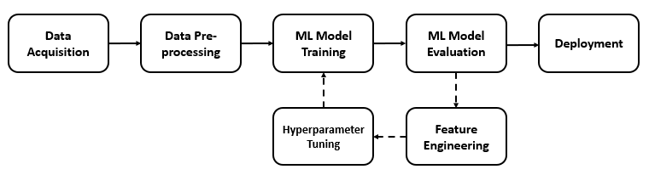
Micro Credit Defaulter Diagram:

Slide 5
Visualization of Micro Credit Defaulter

Slide 6
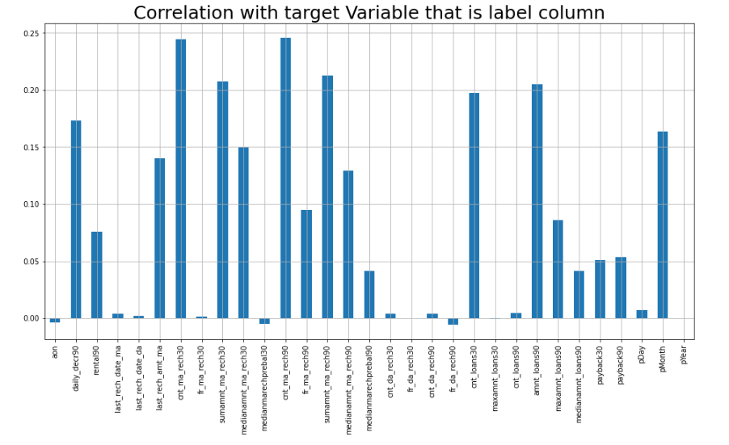
Graphs:
Here we see the correlation of the columns with respect to the target column that is label..

Slide 7
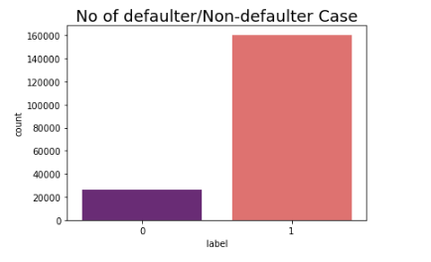
Graphs:
Label 1 indicates loan has been paid i.e Non-Defaulter and label 0 indicates indicates that the loan has not been paid i.e. defaulter.

Slide 8
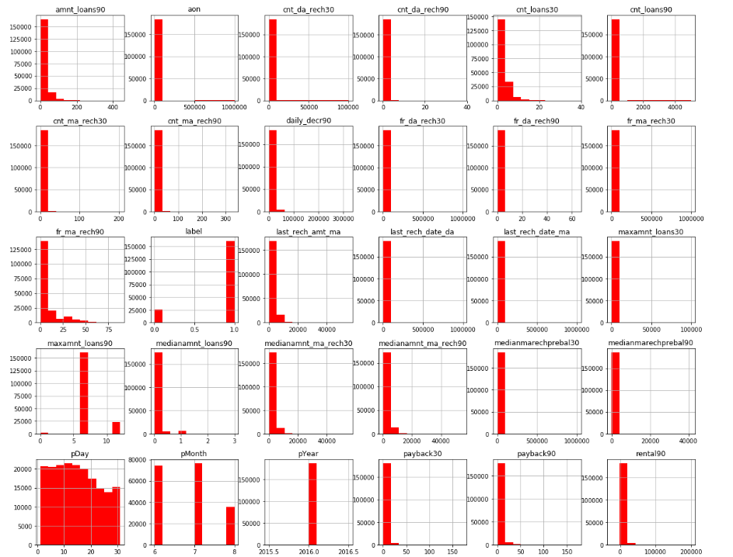
Graphs:
We plot the histogram to display the shape and spread of continuous sample data. In a histogram, each bar groups numbers into ranges. Taller bars show that more data falls in that range

Slide 9
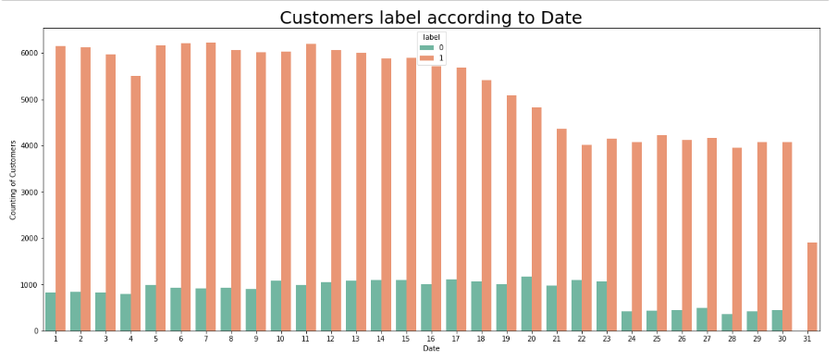
Graphs:
The first figure which is date vs label shows that the customers who did not pay their loans are from date 10 to 23.

Slide 10
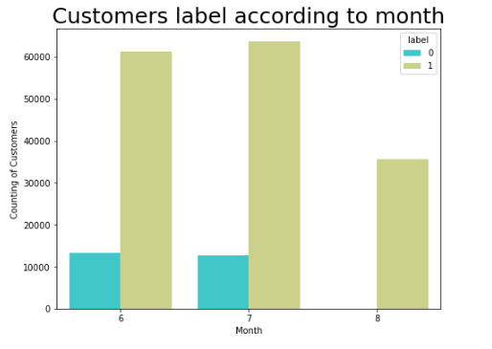
Graphs:
There are several customers at June and July month who did not pay their loan.

Slide 11
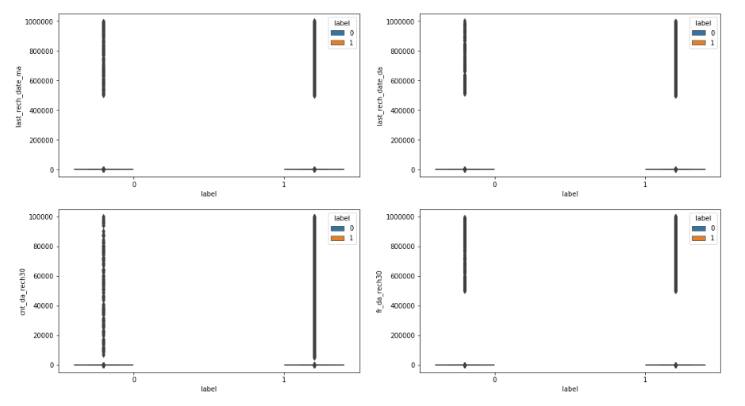
Graphs:
There are too many outliers present in our dataset. So we need to remove it. But before removing please check that only 8 to 10% of data removed.

Slide 12
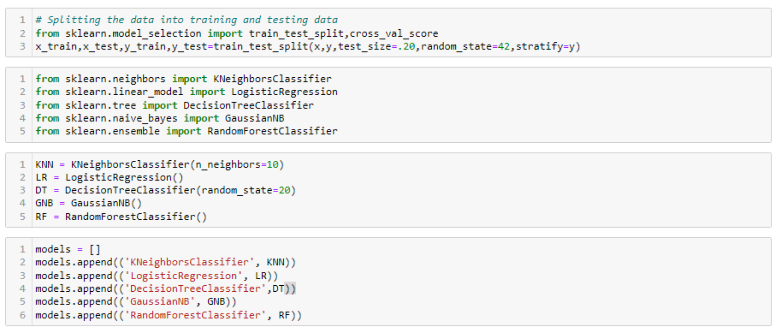
Model Building, Model Evaluation and Selecting the best model

Slide 13
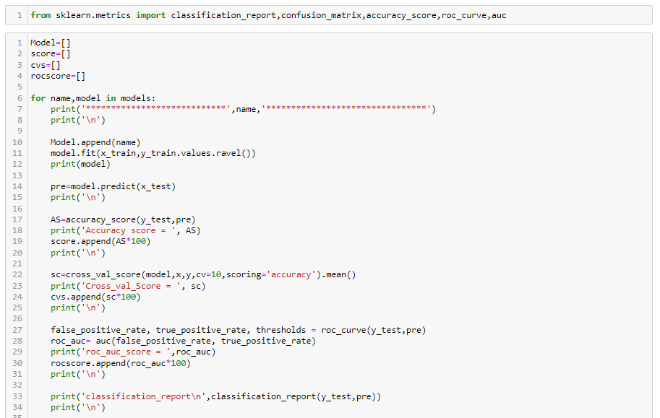
Model Building, Model Evaluation and Selecting the best model

Slide 14
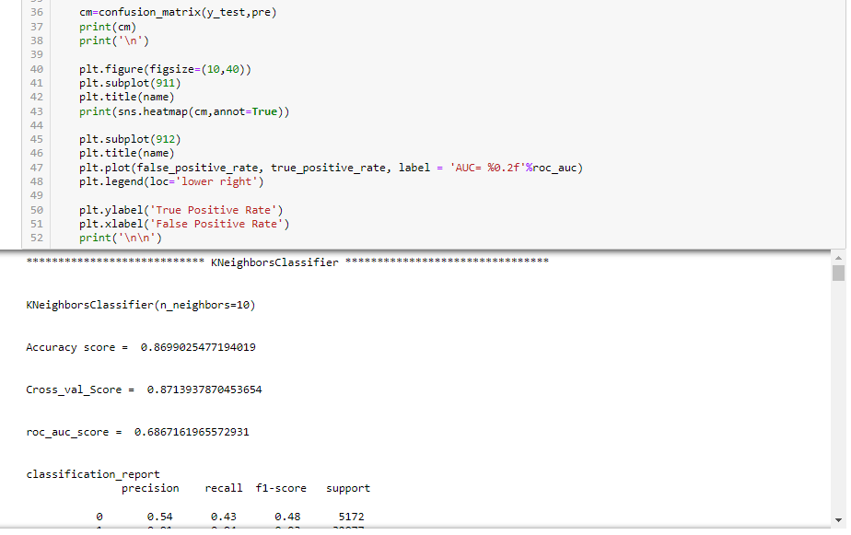
Model Building, Model Evaluation and Selecting the best model

Slide 15
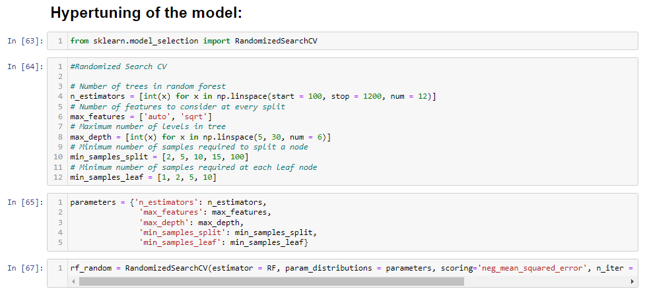
Hypertuning of the model:

Slide 16
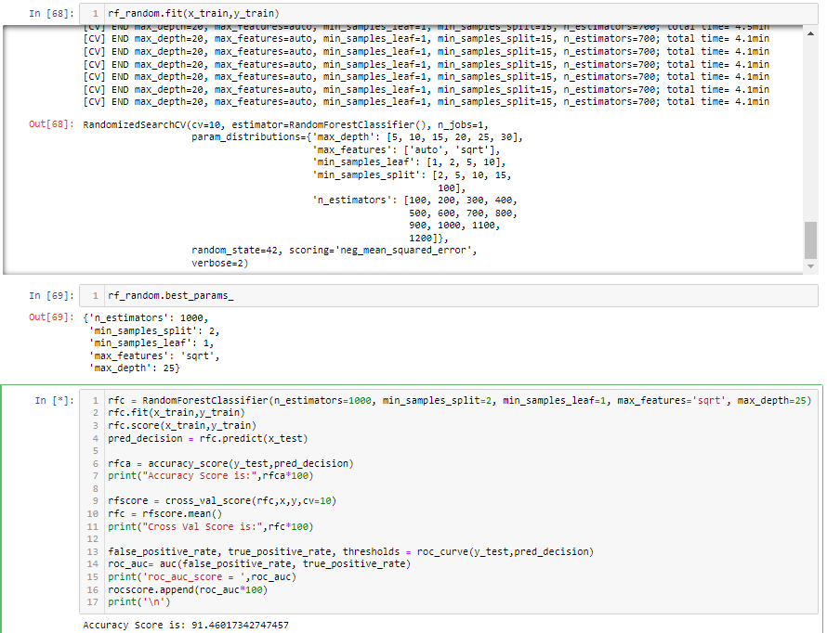
Hypertuning of the model:

Slide 17
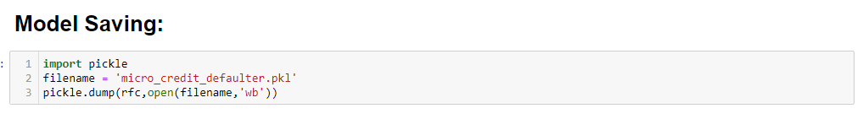
Model Saving:

Slide 18
Conclusion:
This Kernel investigates different models for car price prediction.
Different types of Machine Learning methods including LogisticRegression, RandomForestClassifier, KNeighborsClassifier, GaussianNB and DecisionTreeClassifier in machine learning are compared and analysed for optimal solutions.
Even though all of those methods achieved desirable results, different models have their own pros and cons.
The RandomForestClassifier is probably the best one and has been selected for this problem.
Finally, the RandomForestClassifier is the best choice when parameterization is the top priority.

